Slide 1
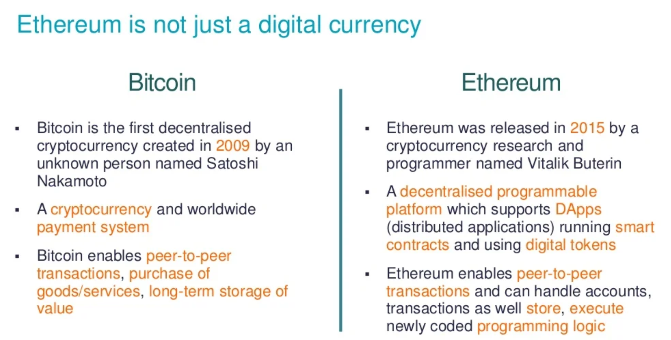
Ethereum vs Bitcoin

Slide 2
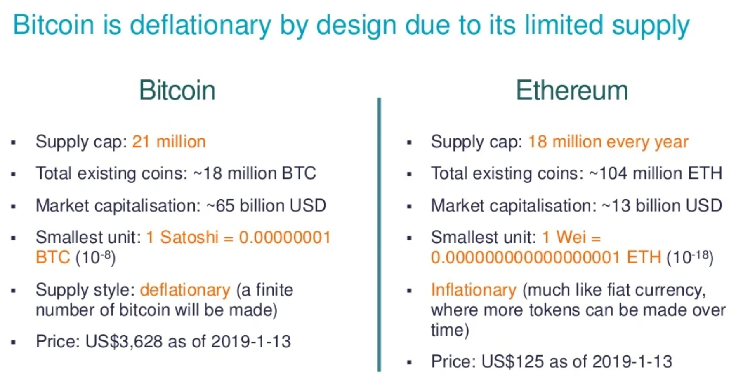
Bitcoin vs Ethereum 2

Slide 3
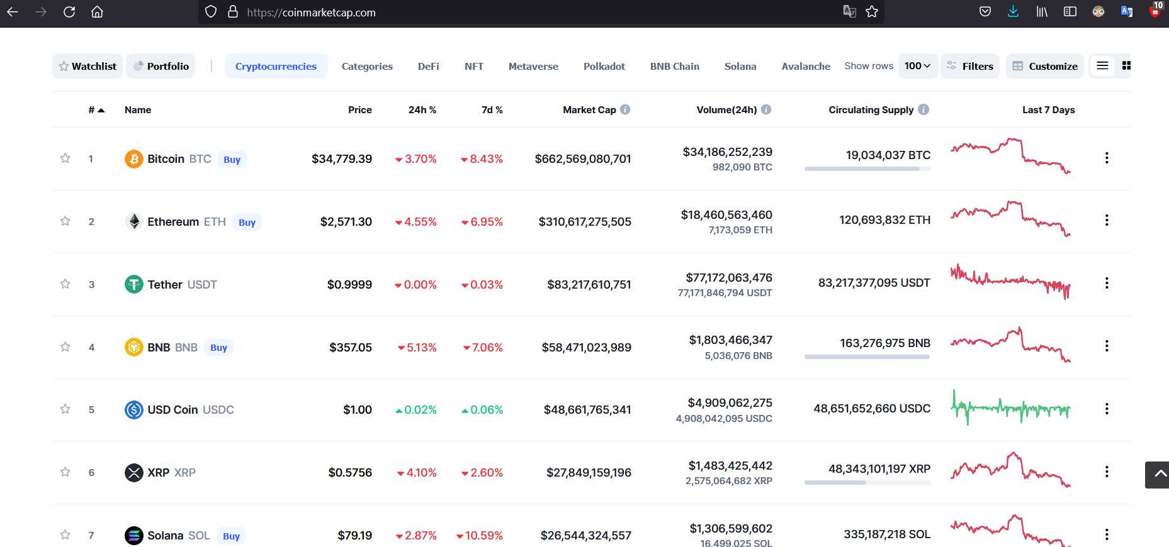
Top Crypto Currencies

Slide 4
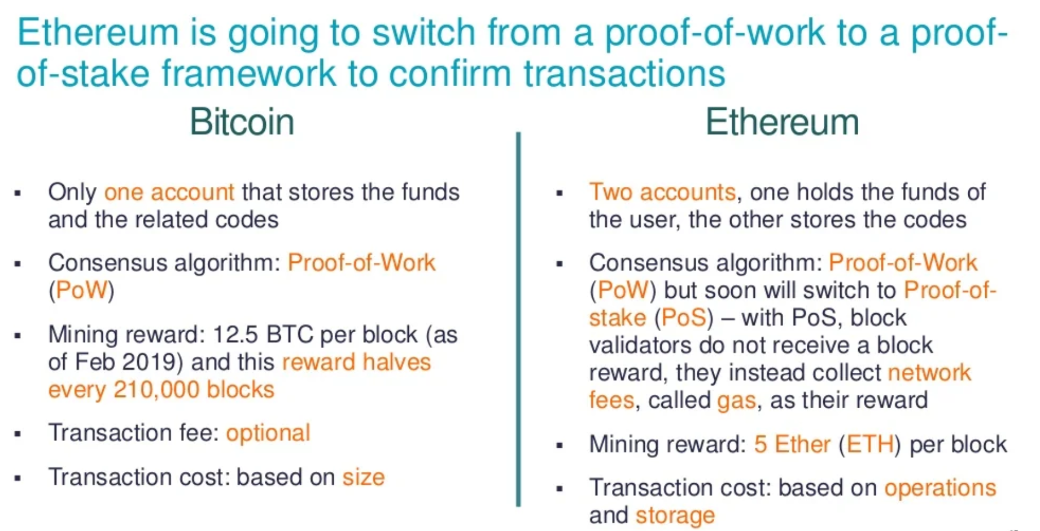
Bitcoin vs Etheruem 3

Slide 5
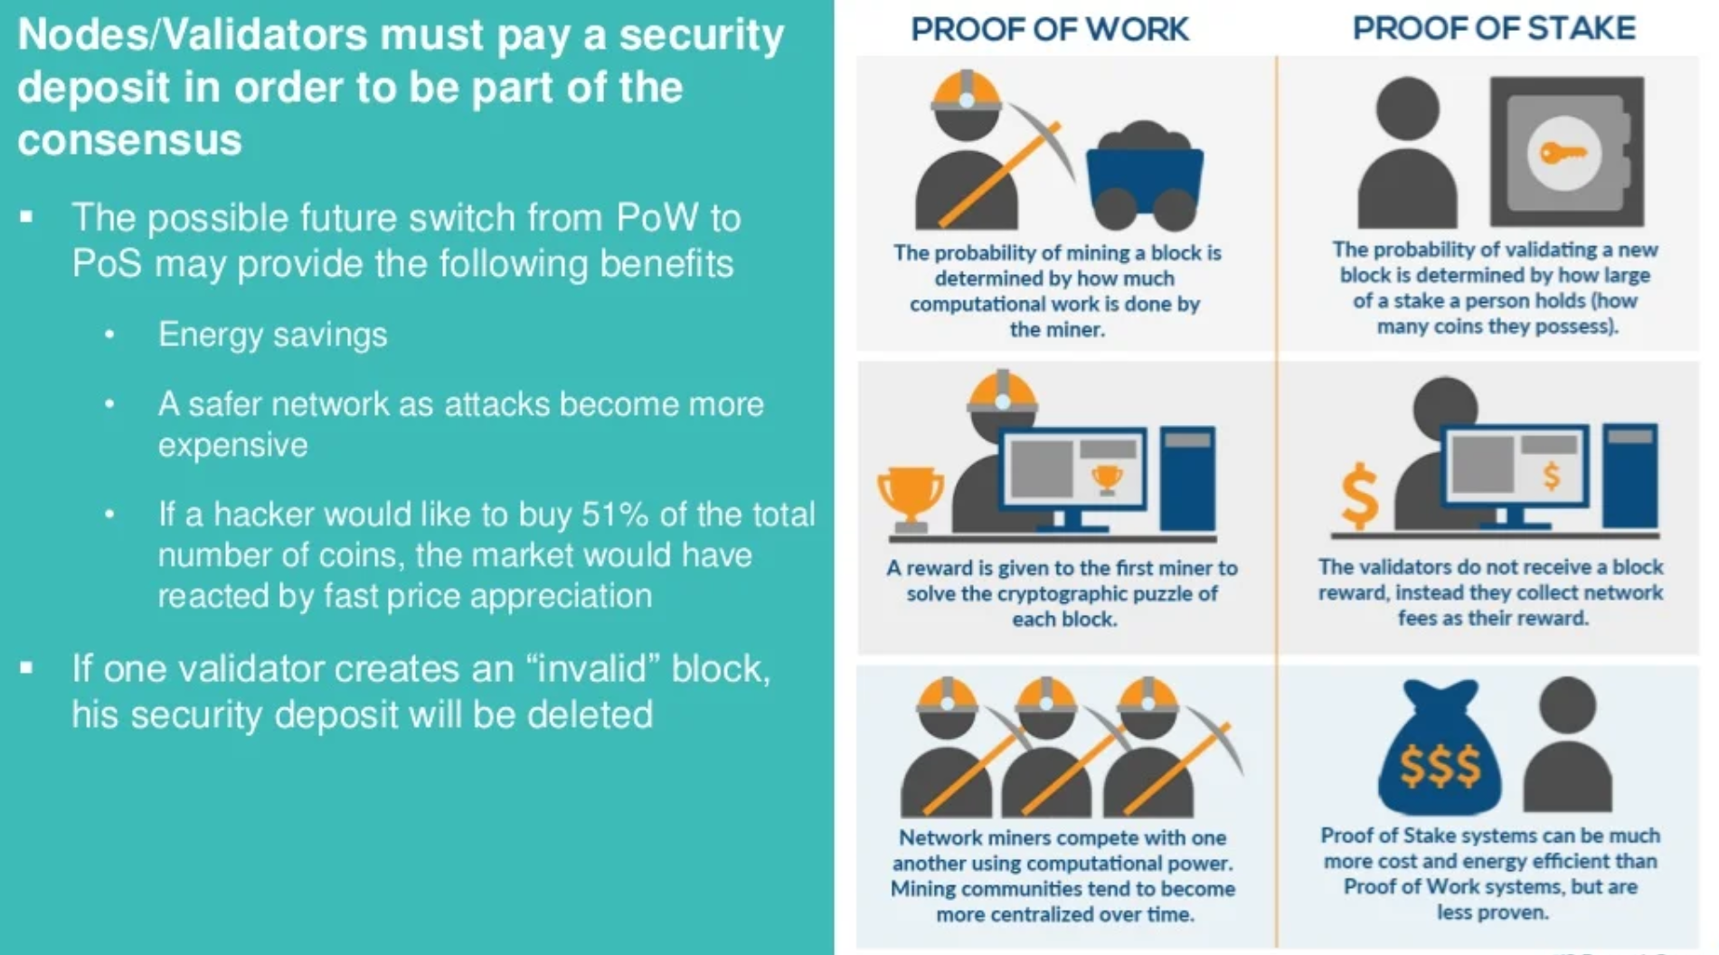
Proof of Work vs Proof of Stake

Slide 6
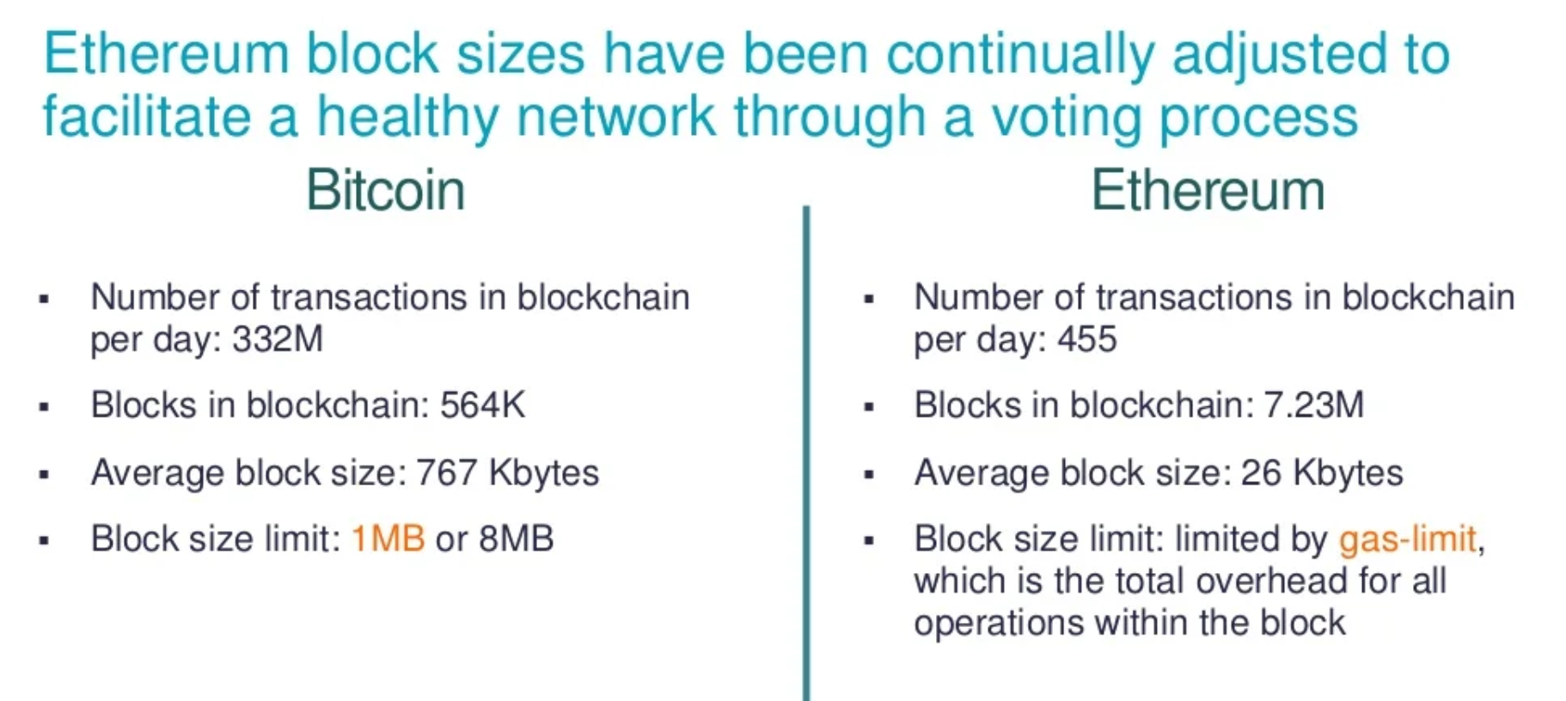
Bitcoin vs Etheruem 4

Slide 7
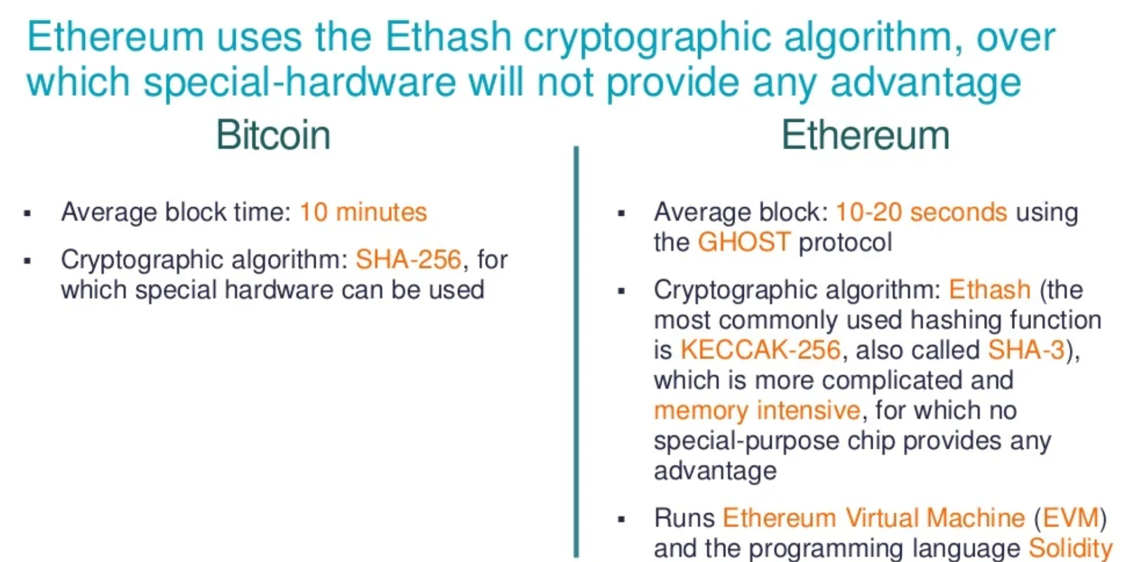
Bitcoin vs Etheruem 4

Slide 8
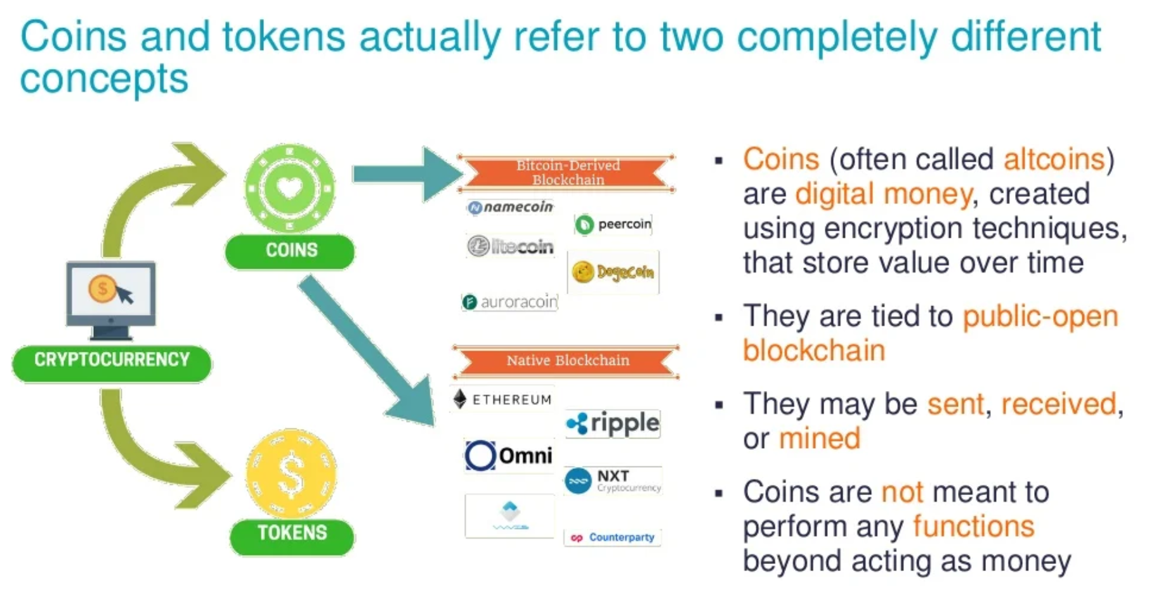
Coins and Tokens

Slide 9
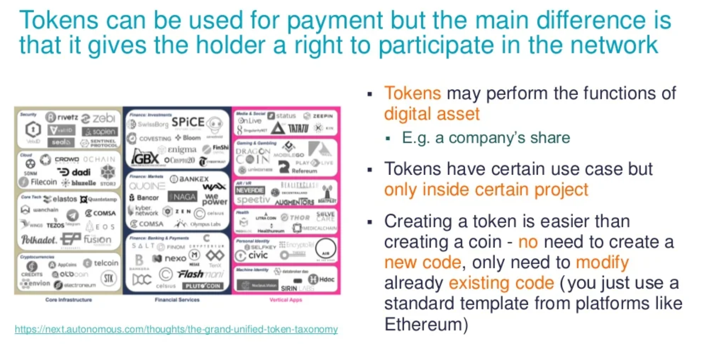
Coins and Tokens 2

Slide 10
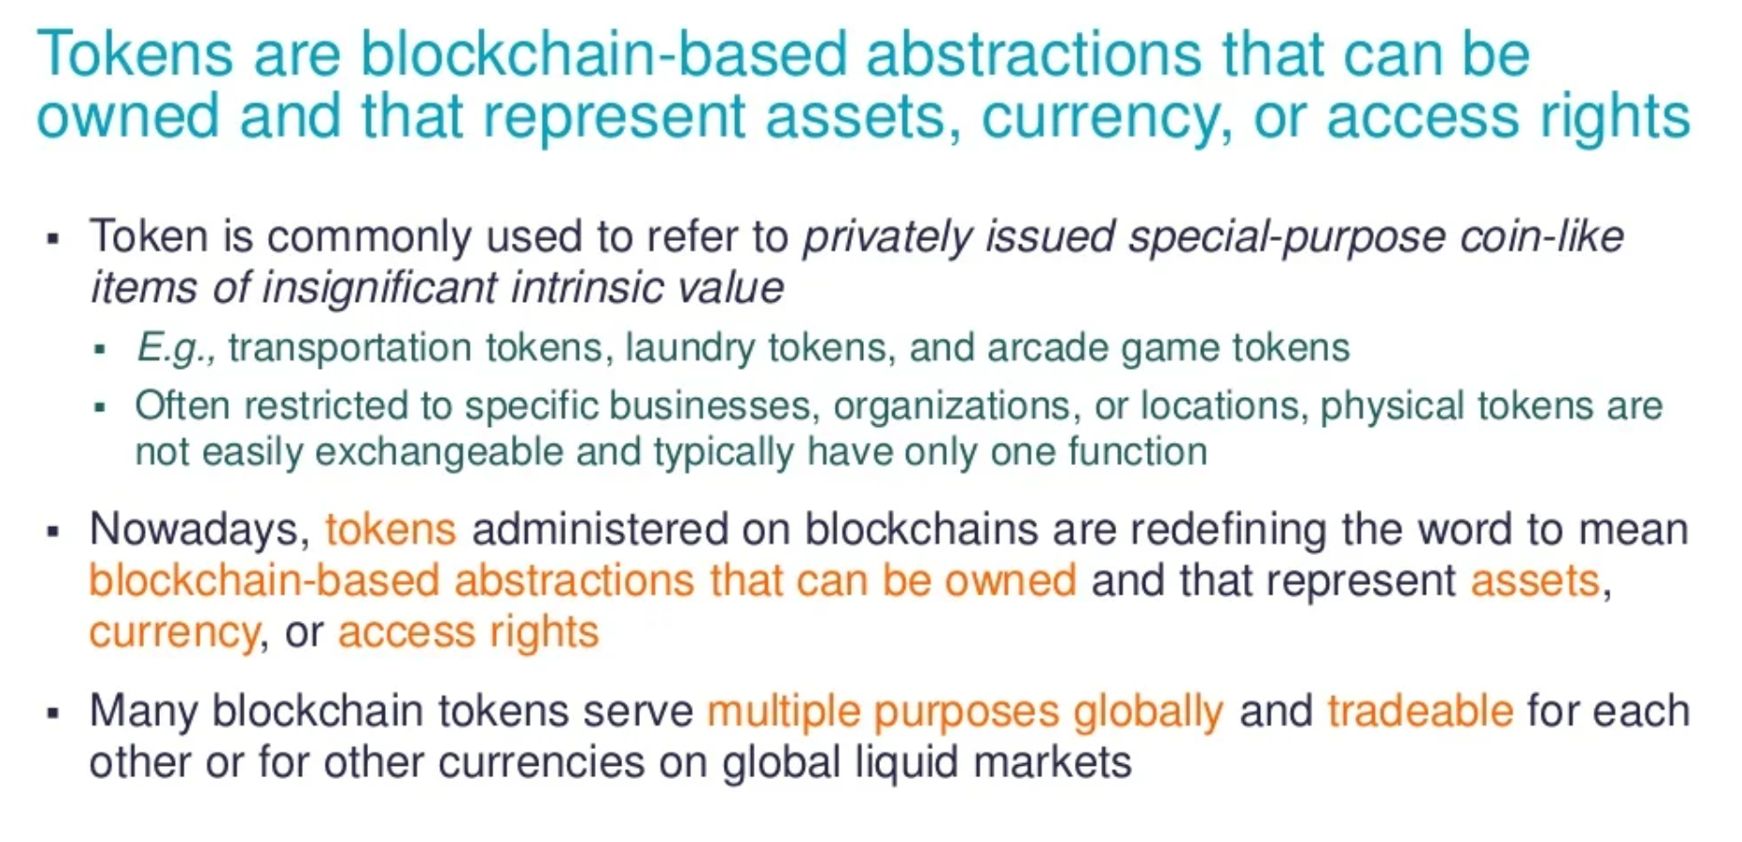
Tokens 1

Slide 11
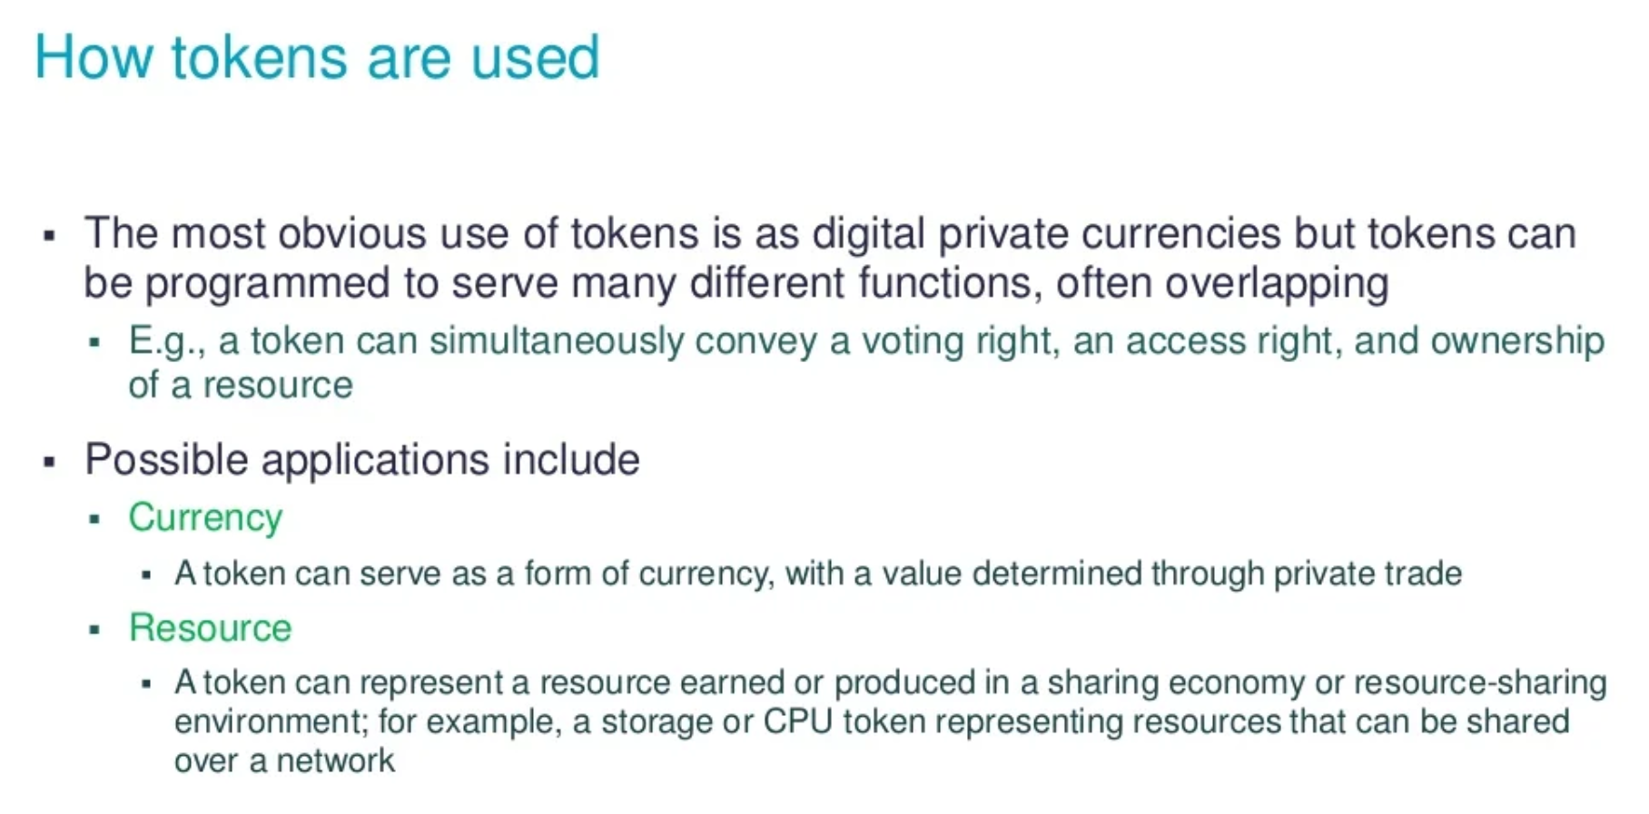
Tokens 2

Slide 12
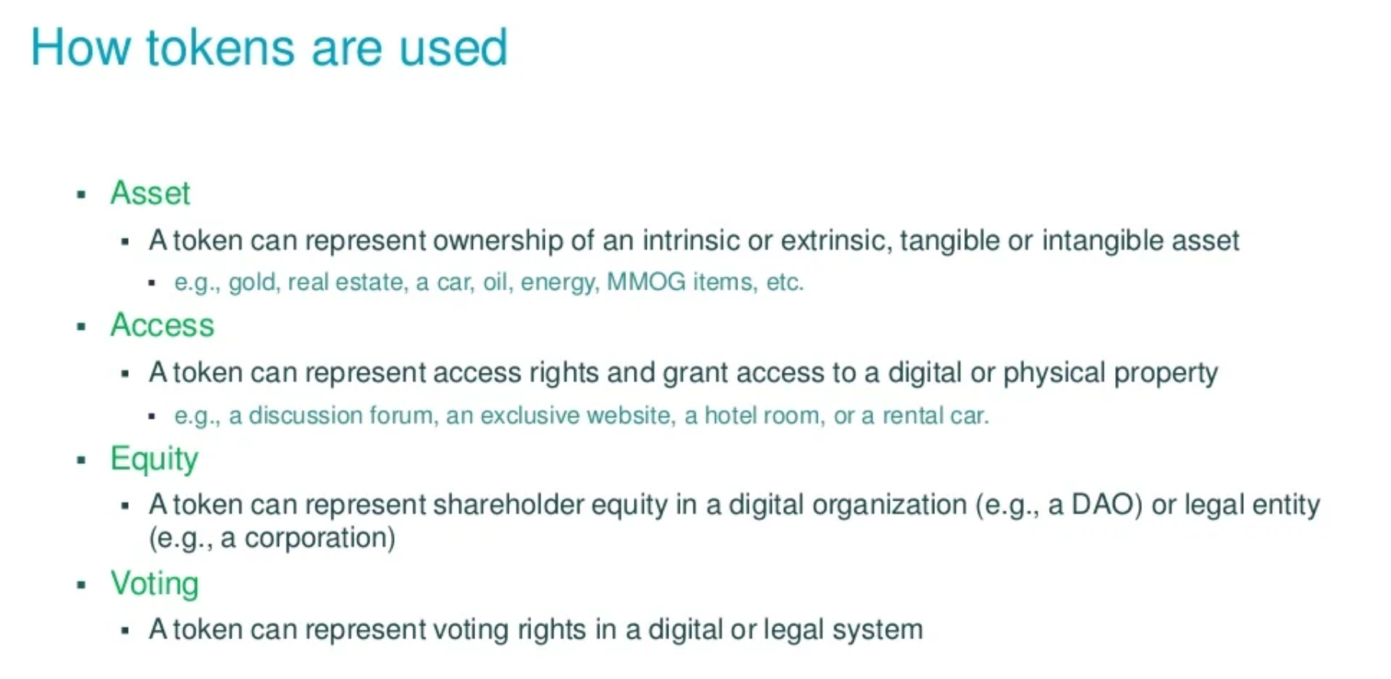
Tokens 3

Slide 13
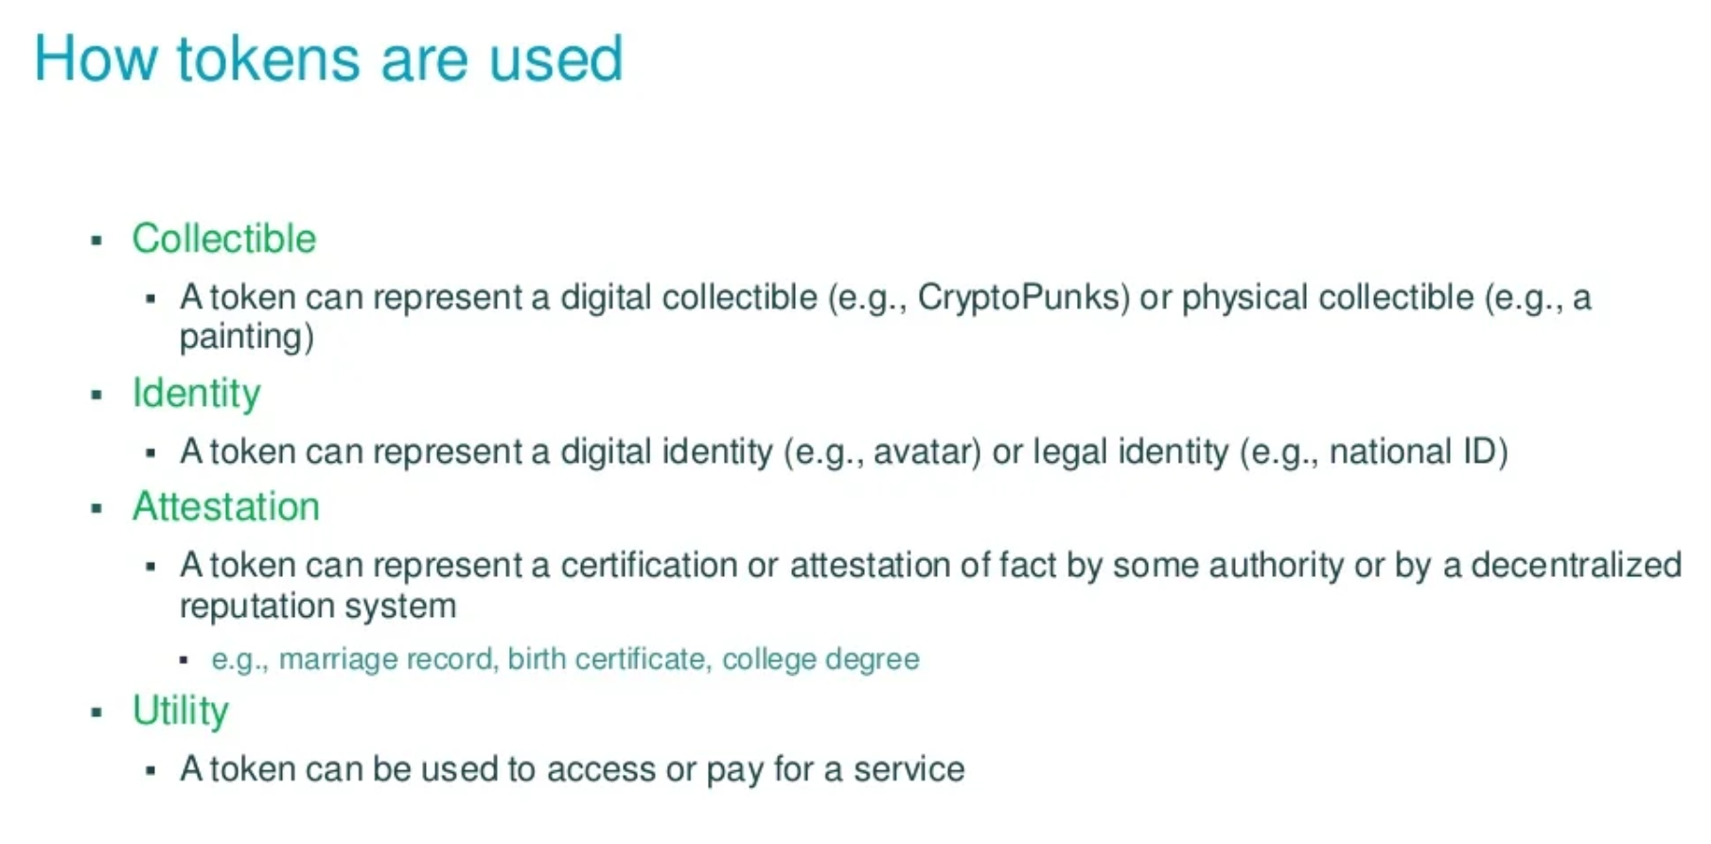
Tokens 4

Slide 14
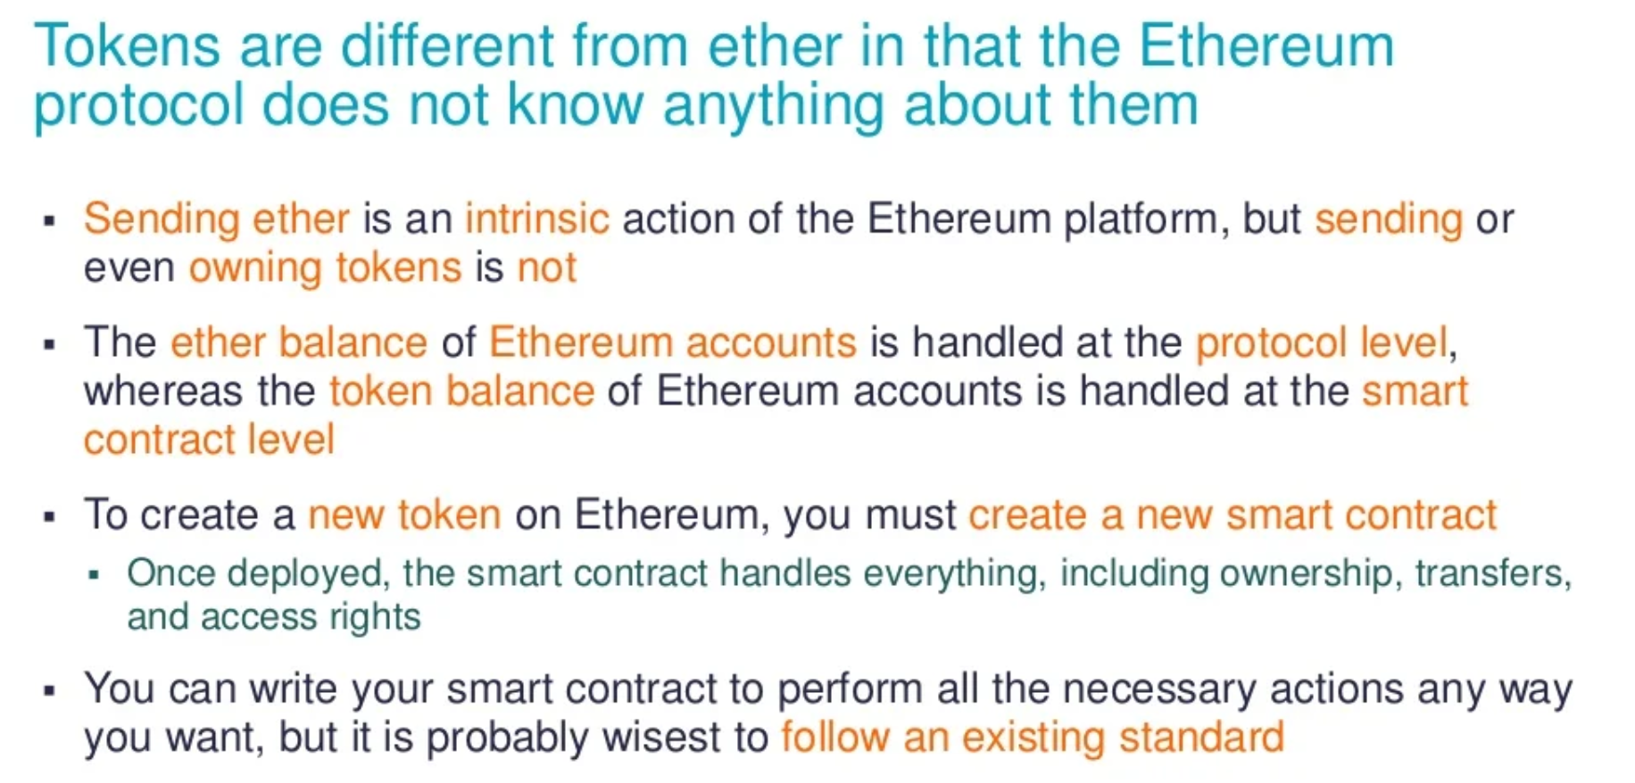
Tokens 5

Slide 15
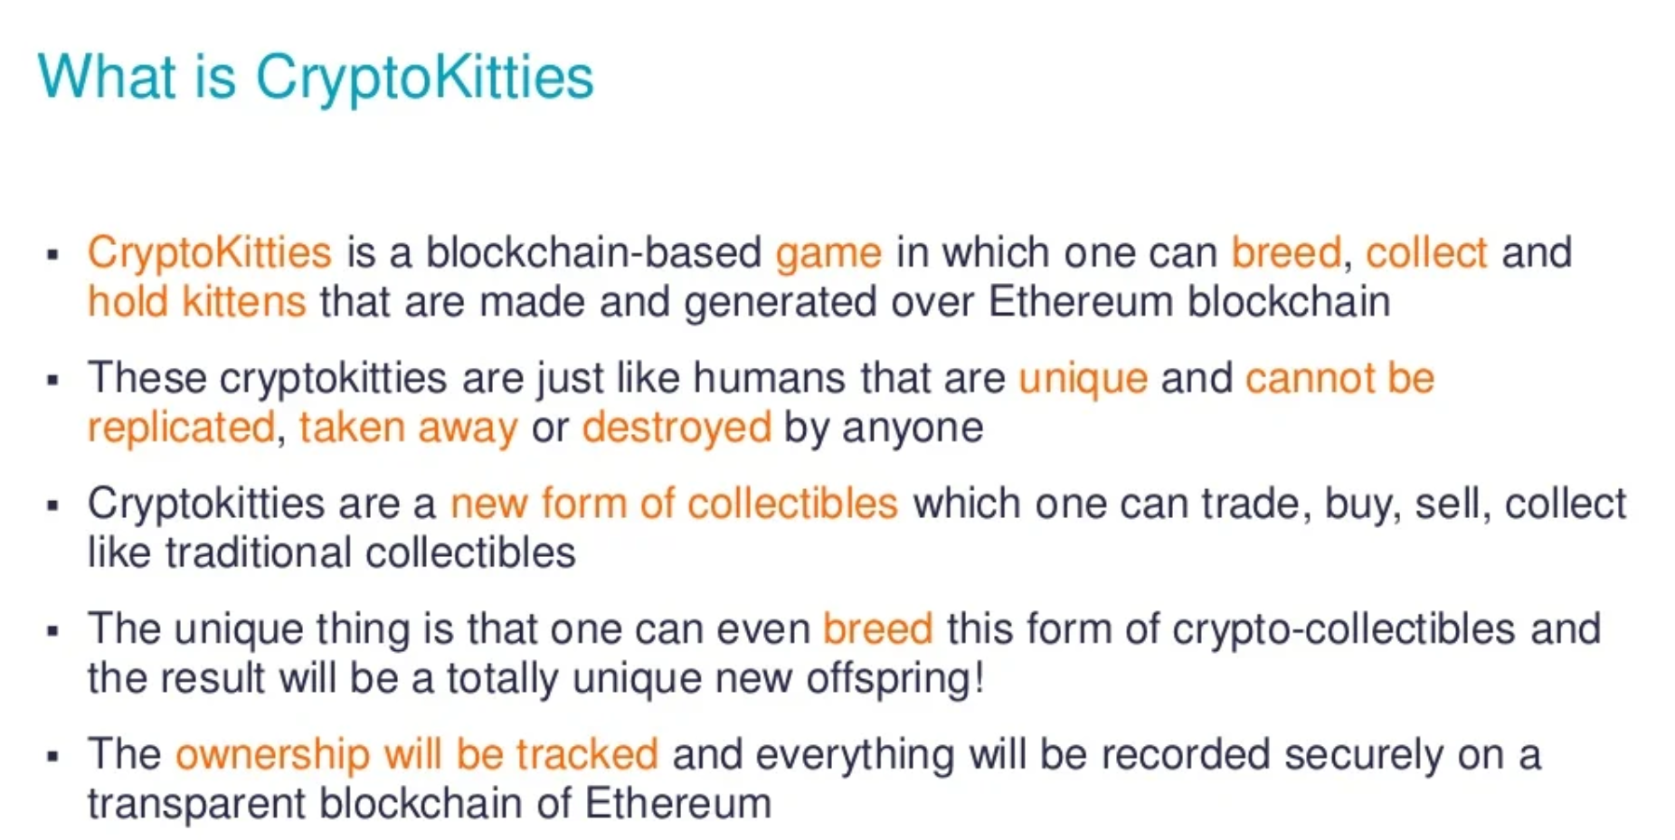
CryptoKitties

Slide 16
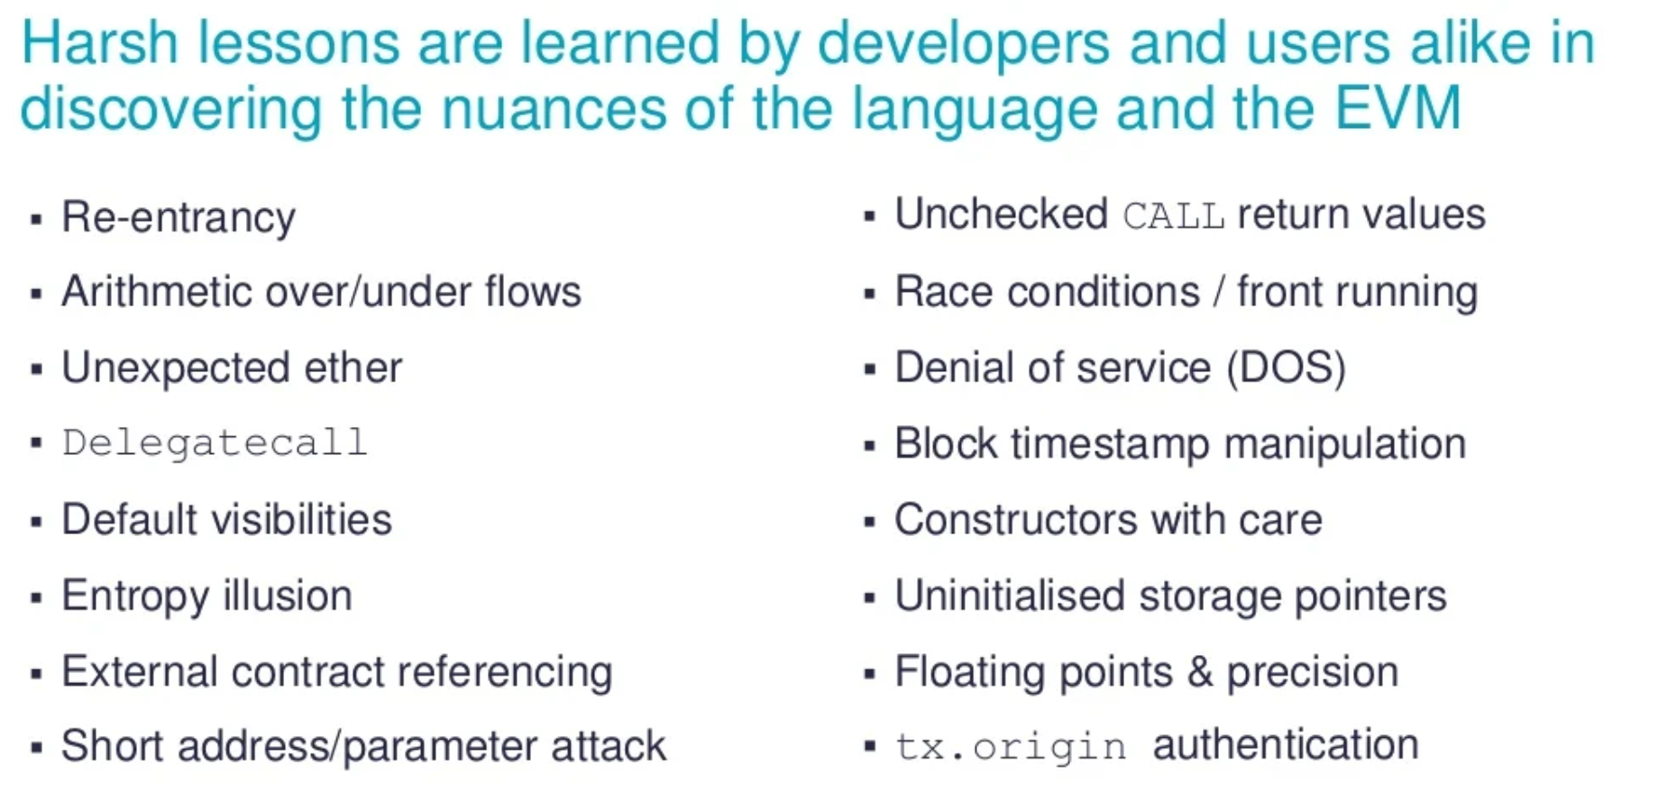
Developer Issues

Slide 17
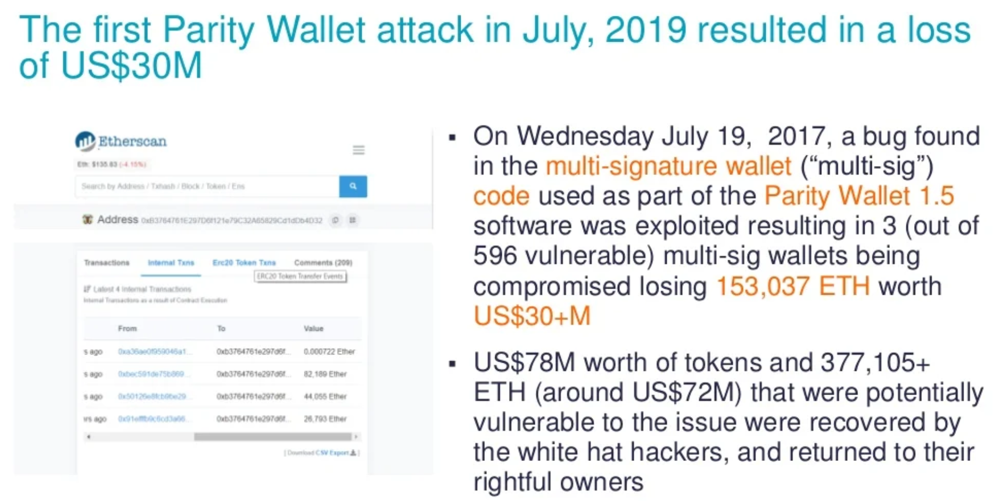
Hacks

